Slide 1


L Stuurman
01-2026

Slide 2

Outline
Executive Summary
Introduction
Methodology
Results
Conclusion
Appendix

Slide 3
Executive Summary
Summary of methodology
Data collection
Data wrangling
Exploratory Data Analysis with Data Visualisation and SQL
Building an interactive map with Folium and a Dashboard with Plotly
Predictive analysis (Classification)
Summary of results
Exploratory Data Analysis results
Interactive analytics visuals
Predictive analysis results

Slide 4
Introduction
Background
SpaceX is a successful space exploration company that is able to continuously top the market with their cost conscious approach. This is why we feel instead of using rocket science to determine if the first stage will land, we can use machine learning models and public information, by learning patterns in data to determine the cost of each launch.

Slide 5

Section 1

Slide 6
Methodology
Executive Summary
Data collection methodology:
Using SpaceX rest API
Perform data wrangling
Filtering data
Replacement/removal of missing values
Binary classification of data using hot encoding
Perform exploratory data analysis (EDA) using visualization and SQL
Perform interactive visual analytics using Folium and Plotly Dash
Perform predictive analysis using classification models
Building, tuning and evaluating classification of models, ensuring the best result

Slide 7
Data Collection
Data collection was done using the SpaceX Rest API as well as Web Scrapping data from tables on the SpaceX Wikipedia page.
FlightNumber | Date | BoosterVersion | PayloadMass | Orbit | LaunchSite | Outcome | Flights | GridFins | Reused | Legs | LandingPad | Block | ReusedCount | Serial | Longitude | Latitude
4 | 1 | 2010-06-04 | Falcon 9 | NaN | LEO | CCSFS SLC 40 | None None | 1 | False | False | False | None | 1.0 | 0 | B0003 | -80.577366 | 28.561857
5 | 2 | 2012-05-22 | Falcon 9 | 525.0 | LEO | CCSFS SLC 40 | None None | 1 | False | False | False | None | 1.0 | 0 | B0005 | -80.577366 | 28.561857
6 | 3 | 2013-03-01 | Falcon 9 | 677.0 | ISS | CCSFS SLC 40 | None None | 1 | False | False | False | None | 1.0 | 0 | B0007 | -80.577366 | 28.561857
7 | 4 | 2013-09-29 | Falcon 9 | 500.0 | PO | VAFB SLC 4E | False Ocean | 1 | False | False | False | None | 1.0 | 0 | B1003 | -120.610829 | 34.632093
8 | 5 | 2013-12-03 | Falcon 9 | 3170.0 | GTO | CCSFS SLC 40 | None None | 1 | False | False | False | None | 1.0 | 0 | B1004

Slide 8
Data Collection – SpaceX API
https://github.com/Lee-AnnS/DataScienceEcosystem/blob/main/jupyter-labs-spacex-data-collection-api.ipynb
Requesting Rocket launch data from SpaceX API
Decoding the response content with .json() and turning it into a data frame using .json_normalize()
Requesting needed information about the launches by applying custom functions
Constructing data we have obtained into a dictonary and creating a data frame from it
Filtering the data frame for only falcon 9 launches
Replacing missing values in Payload Mass column with ,mean()
Exporting the data to csv

Slide 9
Data Collection - Scraping
https://github.com/Lee-AnnS/DataScienceEcosystem/blob/main/jupyter-labs-webscraping.ipynb
Requested falcon 9 launches from Wikipedia
Created BeautifulSoup object from HTML response
Extracted all the column names from HTML table header
Collected the data by parsing HTML tables
Constructed data obtained into a dictionary and created a data frame from the dictionary
Exported the data to csv

Slide 10
Data Wrangling
https://github.com/Lee-AnnS/DataScienceEcosystem/blob/main/labs-jupyter-spacex-Data%20wrangling.ipynb
In the data set, there are several different cases where the booster did not land successfully. Sometimes a landing was attempted but failed due to an accident; for example, True Ocean means the mission outcome was successfully landed to a specific region of the ocean while False Ocean means the mission outcome was unsuccessfully landed to a specific region of the ocean. True RTLS means the mission outcome was successfully landed to a ground pad False RTLS means the mission outcome was unsuccessfully landed to a ground pad. True ASDS means the mission outcome was successfully landed on a drone ship False ASDS means the mission outcome was unsuccessfully landed on a drone ship. We simply converted these outcomes into Training labels with 1 meaning successfully landed and 0 meaning unsuccessful.

Slide 11
EDA with Data Visualization
https://github.com/Lee-AnnS/DataScienceEcosystem/blob/main/edadataviz.ipynb
The following plots can be visualised:
Flight Number vs. Payload Mass, Flight Number vs. Launch Site, Payload Mass vs. Launch Site, Orbit Type vs. Success Rate, Flight Number vs. Orbit Type, Payload Mass vs Orbit Type and Success Rate Yearly Trend Scatter plots show the relationship between variables. If a relationship exists, they could be used in machine learning model. Bar charts show comparisons among discrete categories. The goal is to show the relationship between the specific categories being compared and a measured value. Line charts show trends in data over time (time series).

Slide 12
EDA with SQL
https://github.com/Lee-AnnS/DataScienceEcosystem/blob/main/jupyter-labs-eda-sql-coursera_sqllite.ipynb
Displayed the names of the unique launch sites in the space mission
Displayed 5 records where launch sites begin with the string 'CCA’
Displayed the total payload mass carried by boosters launched by NASA (CRS)
Displayed the average payload mass carried by booster version F9 v1.1
Listed the date when the first succesful landing outcome in ground pad was acheived.
Listed the names of the boosters which have success in drone ship and have payload mass greater than 4000 but less than 6000
Listed the total number of successful and failure mission outcomes
Listed all the booster_versions that have carried the maximum payload mass, using a subquery with a suitable aggregate function.
Listed the records which will display the month names, failure landing_outcomes in drone ship ,booster versions, launch_site for the months in year 2015.
Ranked the count of landing outcomes (such as Failure (drone ship) or Success (ground pad)) between the date 2010-06-04 and 2017-03-20, in descending order.

Slide 13
Build an Interactive Map with Folium
https://github.com/Lee-AnnS/DataScienceEcosystem/blob/main/lab_jupyter_launch_site_location.ipynb
Markers of all Launch Sites:
Added Marker with Circle, Popup Label and Text Label of NASA Johnson Space Center using its latitude and longitude coordinates as a start location. Added Markers with Circle, Popup Label and Text Label of all Launch Sites using their latitude and longitude coordinates to show their geographical locations and proximity to Equator and coasts.
Coloured Markers of the launch outcomes for each Launch Site:
Added coloured Markers of success (Green) and failed (Red) launches using Marker Cluster to identify which launch sites have relatively high success rates.
Distances between a Launch Site to its proximities:
Added coloured Lines to show distances between the Launch Site KSC LC-39A (as an example) and its proximities like Railway, Highway, Coastline and Closest City

Slide 14
Build a Dashboard with Plotly Dash
Launch Sites Dropdown List:
Added a dropdown list to enable Launch Site selection.
Pie Chart showing Success Launches:
Added a pie chart to show the total successful launches count for all sites and the Success vs. Failed counts for the site, if a specific Launch Site was selected.
Slider of Payload Mass Range:
Added a slider to select Payload range.
Scatter Chart of Payload Mass vs. Success Rate for the different Booster Versions:
Added a scatter chart to show the correlation between Payload and Launch Success

Slide 15
Predictive Analysis (Classification)
https://github.com/LeeAnnS/DataScienceEcosystem/blob/main/SpaceX_Machine%20Learning%20Prediction_Part_5.ipynb
Creating a NumPy array from the column "Class" in data
Standardizing the data with StandardScaler, then fitting and transforming it
Splitting the data into training and testing sets with train_test_split function
Creating a GridSearchCV object with cv = 10 to find the best parameters
Applying GridSearchCV on LogReg, SVM, Decision Tree, and KNN models
Calculating the accuracy on the test data using the method score() for all models
Examining the confusion matrix for all models
Finding the method performs best by examining the Jaccard_score and FI_score metrics

Slide 16
Results
Exploratory data analysis results
Interactive analytics demo in screenshots
Predictive analysis results

Slide 17

Section 2

Slide 18
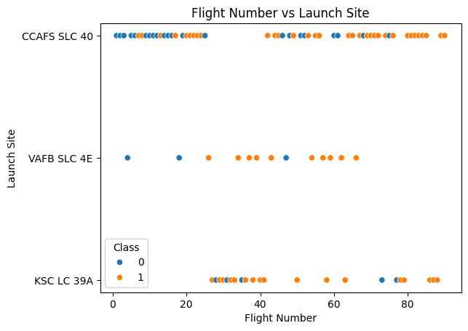
Flight Number vs. Launch Site
The earliest flights all failed while the latest flights all succeeded.
The CCAFS SLC 40 has majority of launches
The VAFB SLC 40 and KSC LC 39A have higher success rates

Slide 19
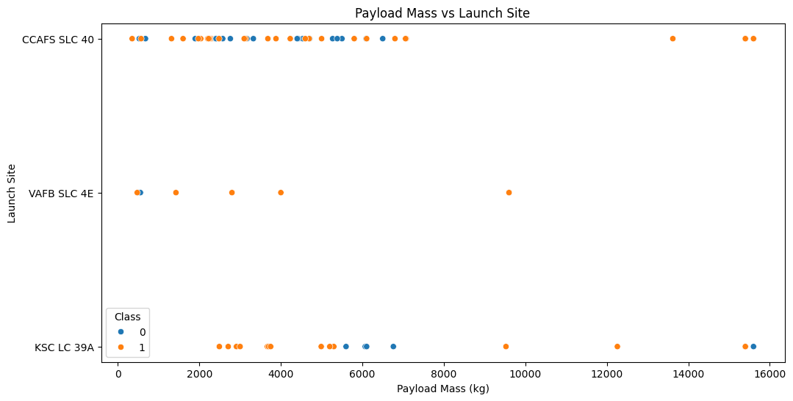
Payload vs. Launch Site
The higher the Payload Mass the higher the success rate
All launches with a payload over 8000kg were successful

Slide 20
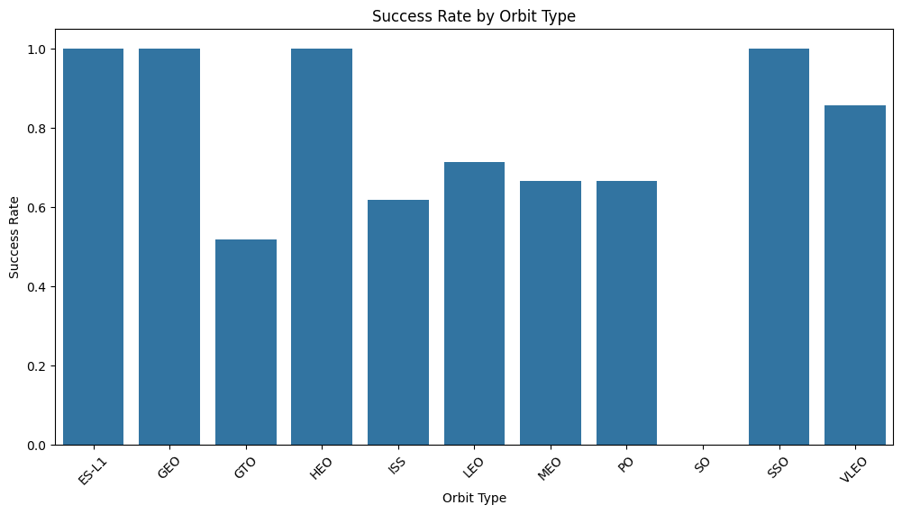
Success Rate vs. Orbit Type
Orbits with 100% success rate are ES-L1, GEO, HEO and SSO
SO had a 0% success rate

Slide 21
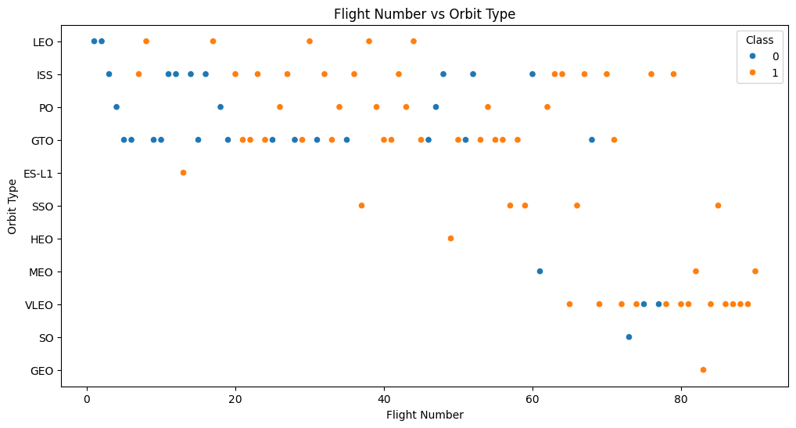
Flight Number vs. Orbit Type
In the LEO orbit the success appears to be related to the number of flights

Slide 22
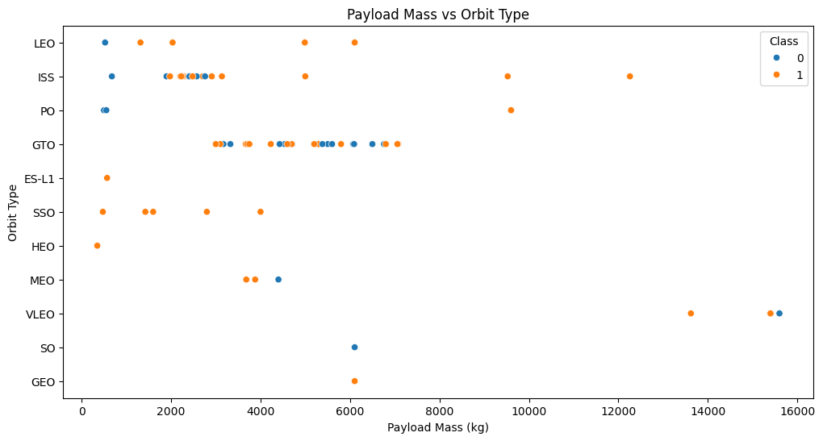
Payload vs. Orbit Type
Heavy payloads have a negative influence on GTO orbits and positive on ISS and LEO orbits

Slide 23
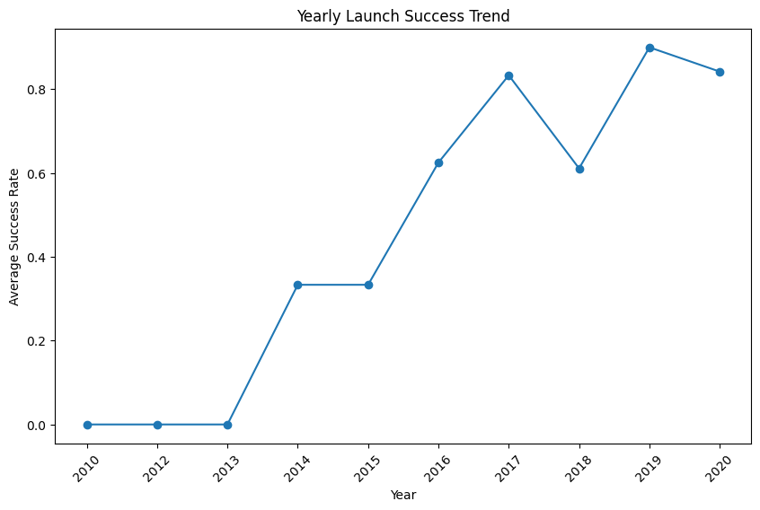
Launch Success Yearly Trend
The has been a launch success rate increase since 2013, which dropped in 2020

Slide 24
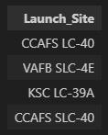
All Launch Site Names
Here are the names of the unique launch sites displayed

Slide 25
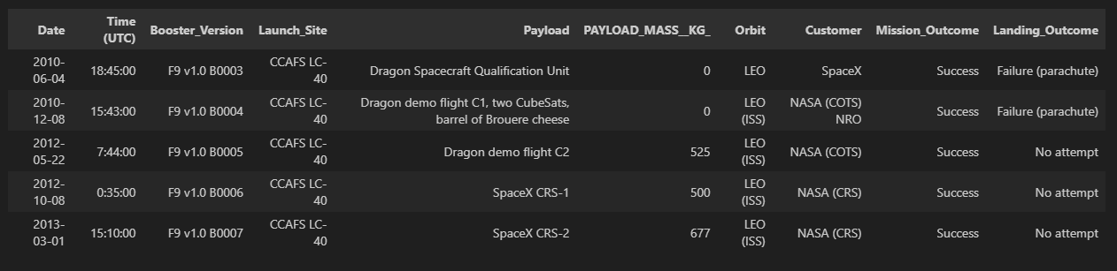
Launch Site Names Begin with 'CCA'
Displaying the 5 records where launch sites begin with the string ‘CCA’

Slide 26
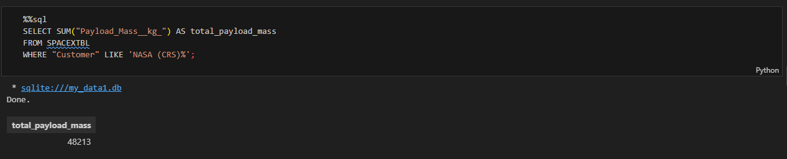
Total Payload Mass
Displaying the total payload mass carried by boosters launched by NASA (CRS)

Slide 27
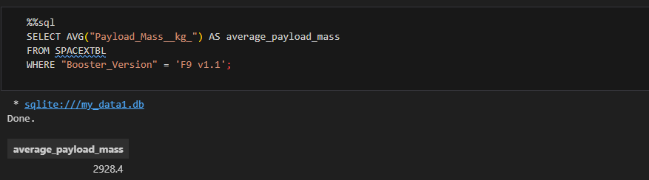
Average Payload Mass by F9 v1.1
Displaying the average payload mass carried by booster version F9 v1.1

Slide 28
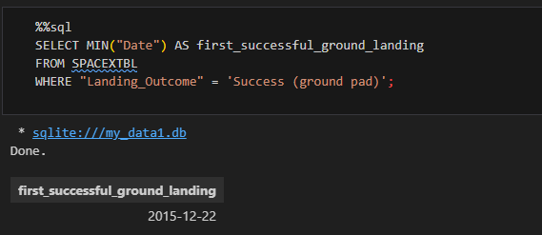
First Successful Ground Landing Date
Listing the date of the first successful ground landing

Slide 29
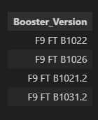
Successful Drone Ship Landing with Payload between 4000 and 6000
Listing the names of the boosters which have success in drone ship and heavy payload mass greater than 4000 but less than 6000

Slide 30
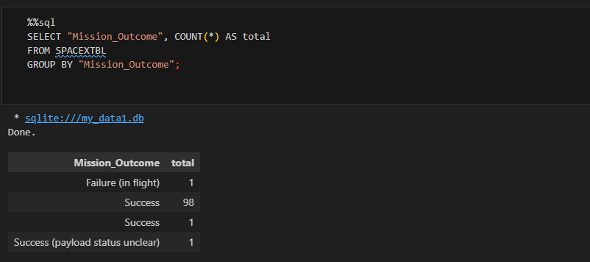
Total Number of Successful and Failure Mission Outcomes
Listing the total number of successful and failure mission outcomes

Slide 31
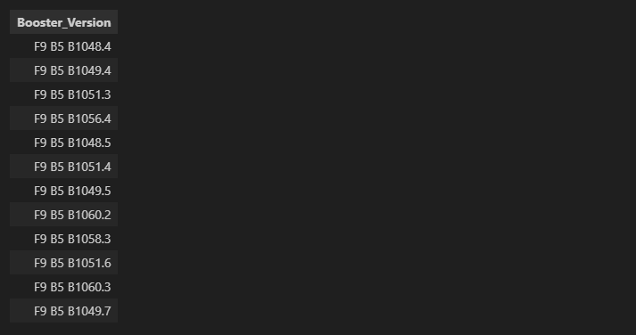
Boosters Carried Maximum Payload
Listing the names of the booster versions which have carried the maximum payload masses

Slide 32
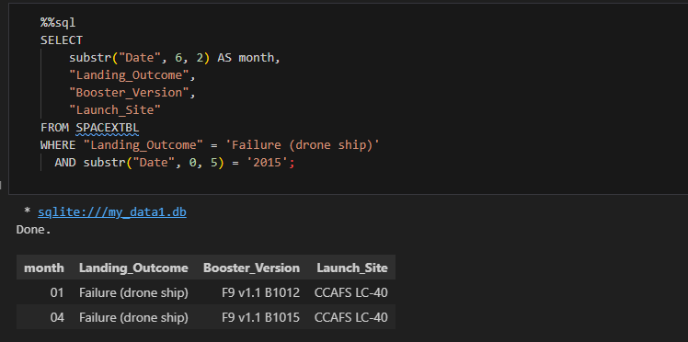
2015 Launch Records
Listing the failed landing outcomes in the year 2015

Slide 33
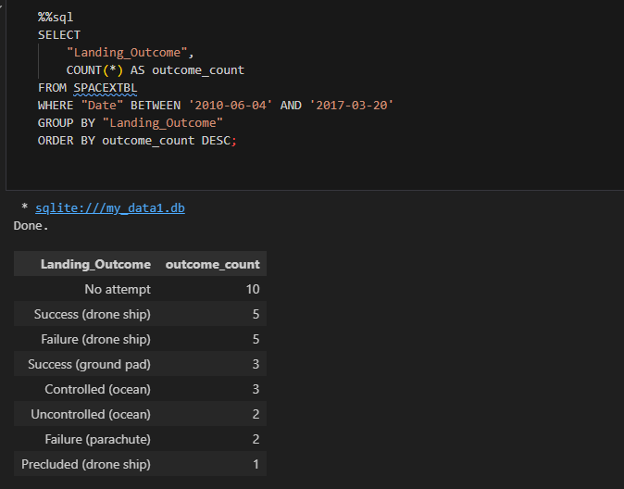
Rank Landing Outcomes Between 2010-06-04 and 2017-03-20
Ranking the count of landing outcomes between the date 2010-06-04 and 2017-03-20 in descending order

Slide 34

Section 3

Slide 35
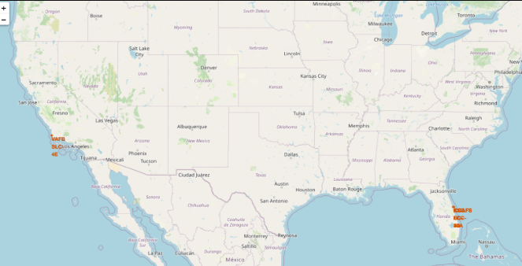
Launch Site location marker map
Most of Launch sites are in proximity to the Equator line because the land is moving faster at the equator than any other place on the surface of the Earth.
All launch sites are in very close proximity to the coast; while launching rockets towards the ocean it minimizes the risk of having any debris dropping or exploding near people.

Slide 36
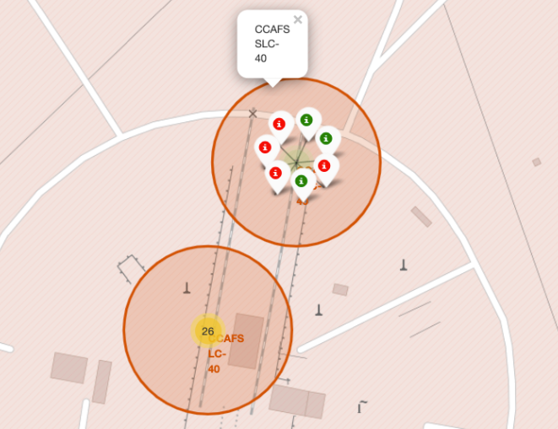
Colour labeled launch records map
From The coloured labelled markers we can easily see which launch sites have relatively high success rates (green markers ) and low success rates (red markers)

Slide 37
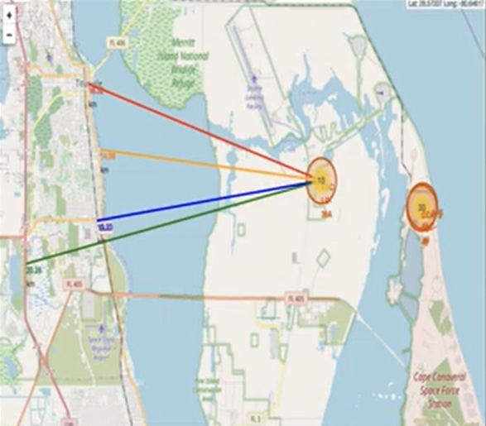
From KSC LC-39A launch site to proximities
The launch site is close to the coastline, railway and highway
Its closest city is Titusville which is 16,32km away

Slide 38

Section 4

Slide 39
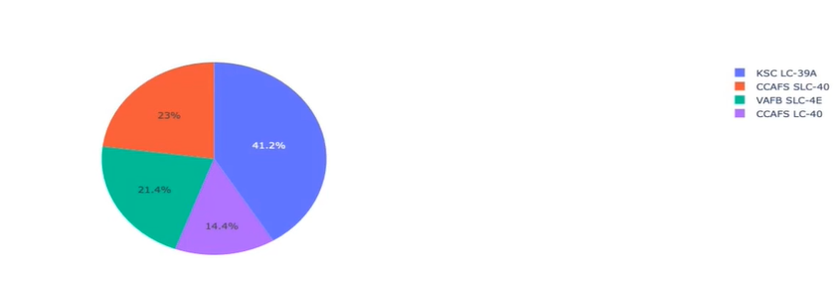
Total successful launches by site
KSC LC-39A is clearly shown to be the most successful site and CCAFS LC-40 is the least

Slide 40
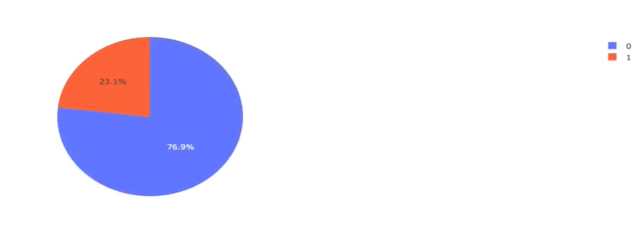
Total successful launches for the KSC LC-39A site
Shows a high success rate with 10 successes and 3 failed landings

Slide 41

Section 5

Slide 42
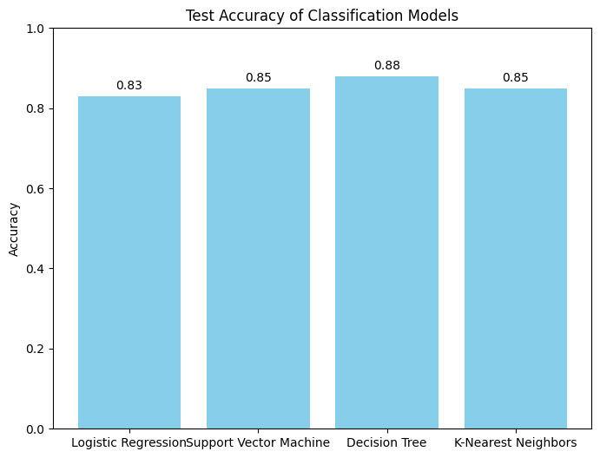
Classification Accuracy
The bar graph confirms that the Decision Tree model was the best performing with the highest accuracy

Slide 43

Confusion Matrix
Logistic Regression performed the best as it had the most true positives. It had a few number of false positives meaning it can distinguish between classes

Slide 44
Conclusions
Decision Tree is the best performing model for this dataset
Launches with low payload mass performed better than those with higher payload masses
Most launch sites are in proximity to the equator and the coastline
Launch success rate increases over the years
KSC LC-39A has the highest launch success rate

Slide 45


